Slide 1
Detecting IP Spoofing Using TTL Forensics
Joe Faulls - 1447637

Slide 2
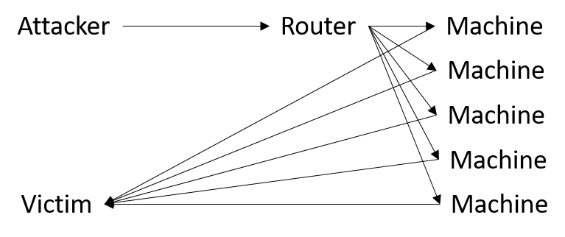
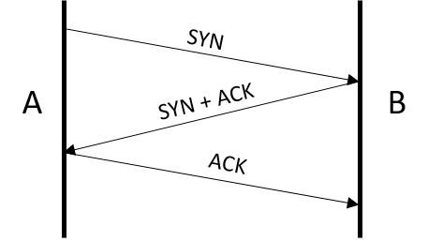
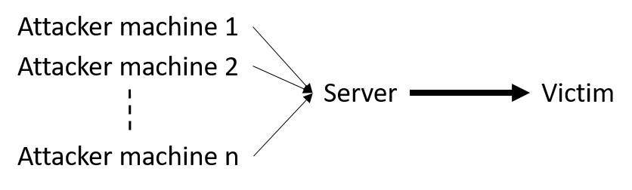
IP Spoofing
Smurf Attack
TCP-SYN Flood
Reflective UDP Amplification
A
SYN
B
SYN + ACK
C

Slide 3
Current Work
Eliminating spoofed packets when a router/device is close enough
Encoding route information in packets

Slide 4
Using TTL

Slide 5
Using TTL
Assumptions: - The route taken by separate requests from the same source are the same, or very similar
- Routes change infrequently and not by much

Slide 6
Using TTL
If a packet arrives with a TTL value statistically different enough from the expected one for the given source address, we can assume that the packet has taken a very different route to get there.

Slide 7
Data Collection

Slide 8
Data Collection – Engineering Challenges
Utilising threads
Efficient data structures
Multiple writes/one read

Slide 9

Data Structures

Slide 10
LEVEL UP

Slide 11
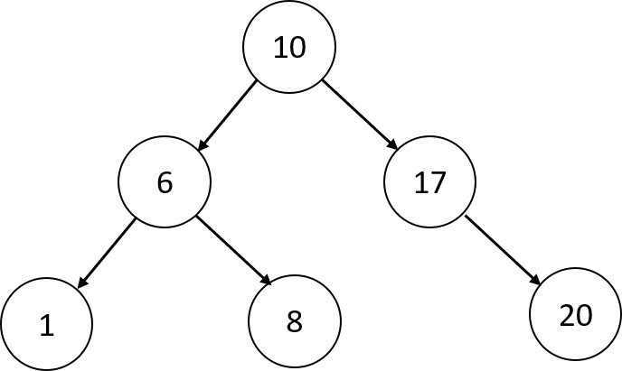
Data Structures
Hash Tables
Judy Arrays

Slide 12
KThreads
One per processor, taking work out of a workqueue
Data is aggregated every time interval into userspace and inserted into a database

Slide 13
Demonstration

Slide 14
From here
Collect data
Method of clustering IP addresses
Method of classifying correctness of TTL value

